Slide 1
Email Campaign Management System
Architecture Case interview

Slide 2
Features
FR
Send HTML Emails
Email template gallery
Email scheduling
Track email open Rate
Bulk email based on segmentation
NFR
Scalable to handle large scale email recipients
Scalability in terms of messaging type.
Durable/Reliable with minimum to no loss accompanied with easy retry and tracking
High Performance – Near real time delivery

Slide 3
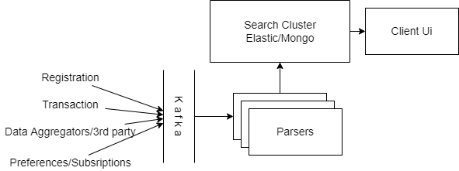
Segmentation architecture

Slide 4
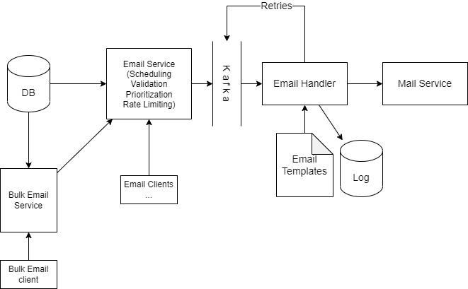
Architecture Overview

Slide 5
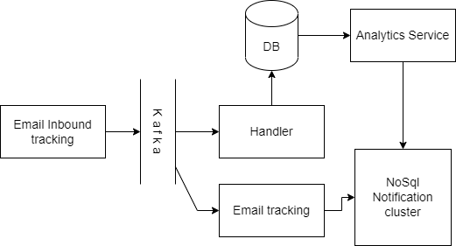
Inbound Architecture

Slide 6
Optimizations
Add Cache for user and preferences data
System can be expanded to handle different types of message delivery
Customized templated cache can be created for frequently common data.
Analytics based topics can be setup for auto action suggestion.
Dynamic template management through User interface
Adding personalization and configurations per user.

